Slide 1
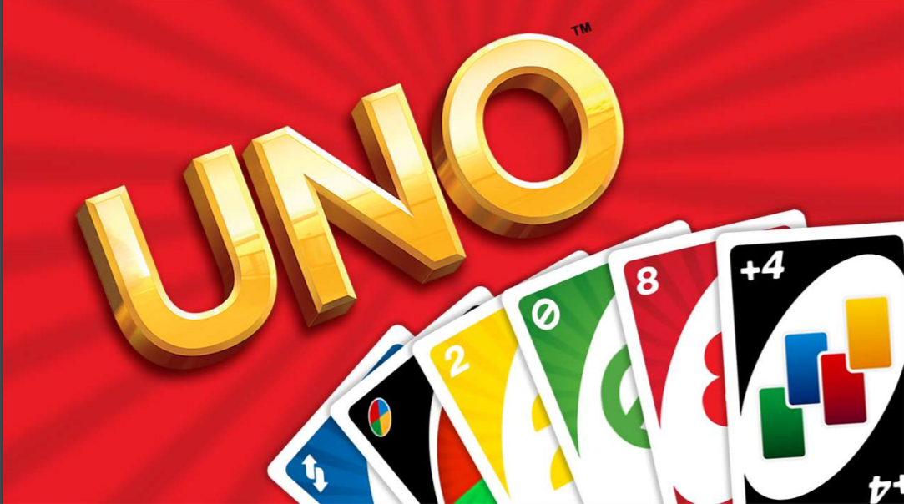
Neha Bais MET – CS 521

Slide 2
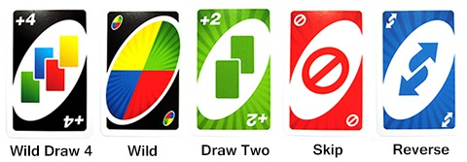
Game Initial Set up
Cards | Quantity
Index 0 | 1 card for each of 4 suits
Index [1 - 9] | 2 cards for each of 4 suits
Skip Card | 2 cards for each of 4 suits
Reverse Card | 2 cards for each of 4 suits
Draw 2 Card | 2 cards for each of 4 suits
Wild Card | 4 cards
Wild Draw 4 | 4 cards
There is a deck of 108 cards
It has 4 suits:
Red
Green
Yellow
Blue
Apart from 0 – 9 index cards, there are 5 special cards implemented.
This is a 2-4 player game.
There is a discard pile of cards from which the cards will be drawn once the deck is empty.

Slide 3
Playing Rules
You must play a valid card either of same number or same colour or wild card
Reverse card changes the direction of play
Draw 2 card makes the next player to draw 2 cards and skip their turn
Skip card , skips the next player's turn
Wild card : allows the player to change the colour of game
Wild Draw 4 : allows the player to change the colour as well as makes the next player to draw 4 cards and skips their turn
You can draw a card from deck if you don't have a valid card to play
Player who replenishes his hand first will win

Slide 4
Classes and Modules Used
External Libraries Used: random and sys
Classes:
UnExpectedValueError: Exception handling for invalid user input
UnoCard: Returns the Card’s instance as string with card index and card color.
Player: Returns the instance of player as string with player name and hand
Deck: Class to create a deck of cards and check whether deck is empty or not
Game: Contains the main functioning of game

Slide 5
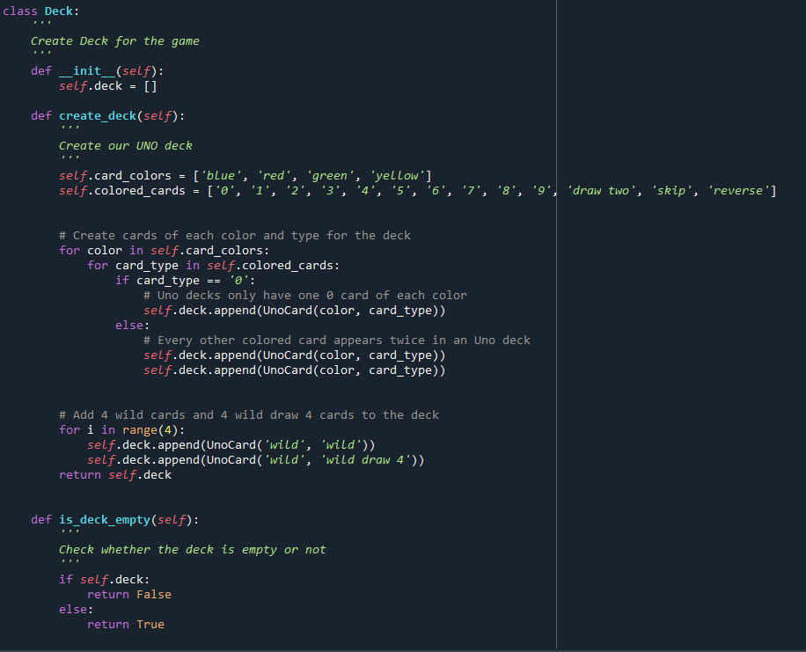
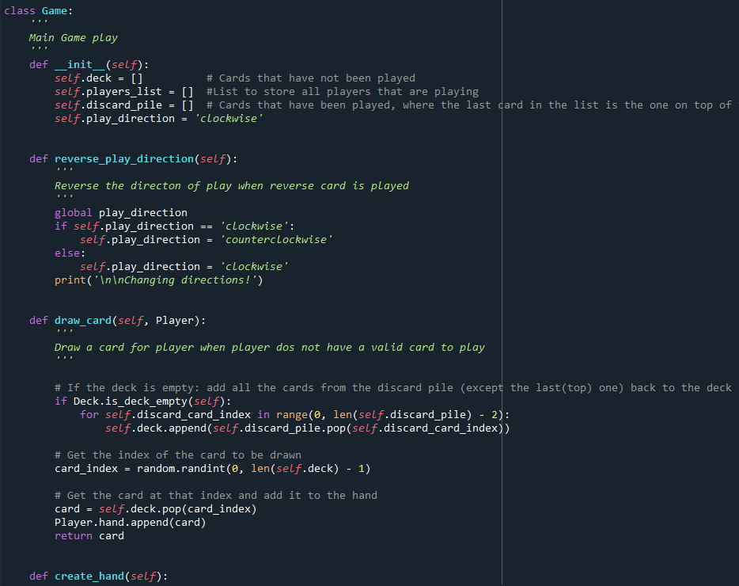
Classes and Objects Example
Class Deck
Class Game

Slide 6
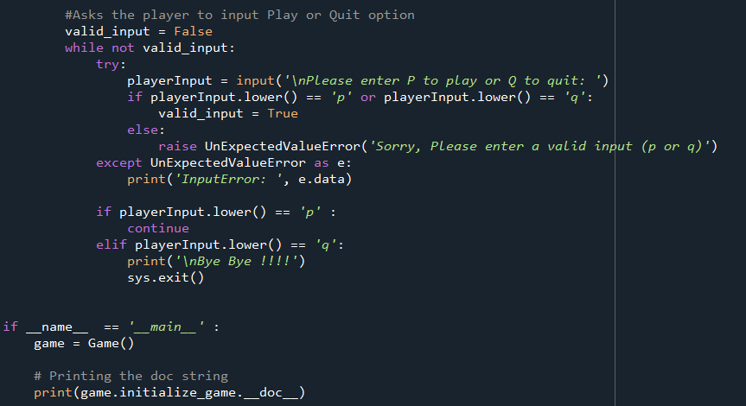
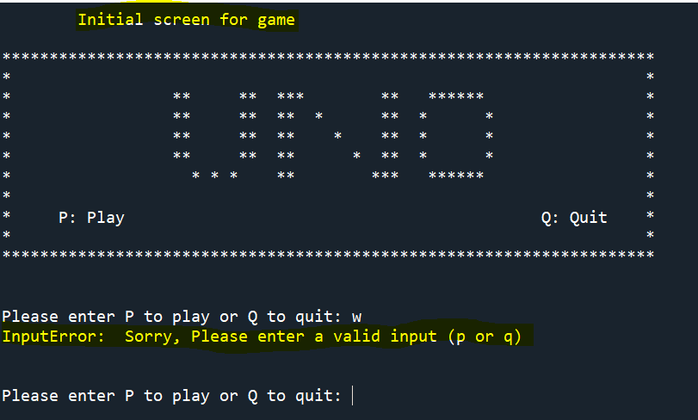
Try except block
Excepts 2 valid options:
P : Play game Q : Quit game
If user input any other option, it is handled using try exception block
Printing the doc-string

Slide 7
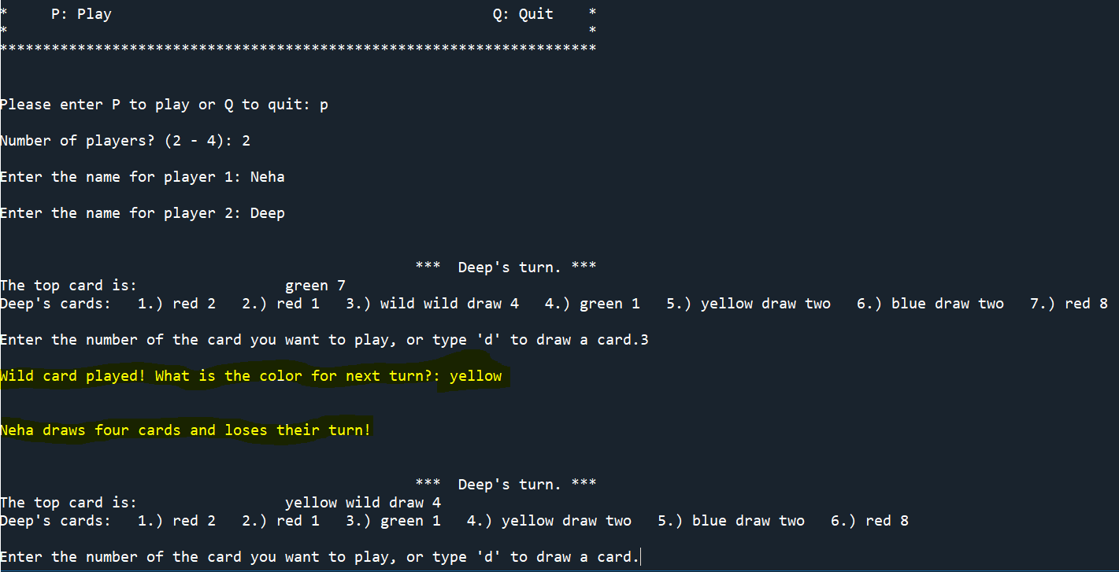
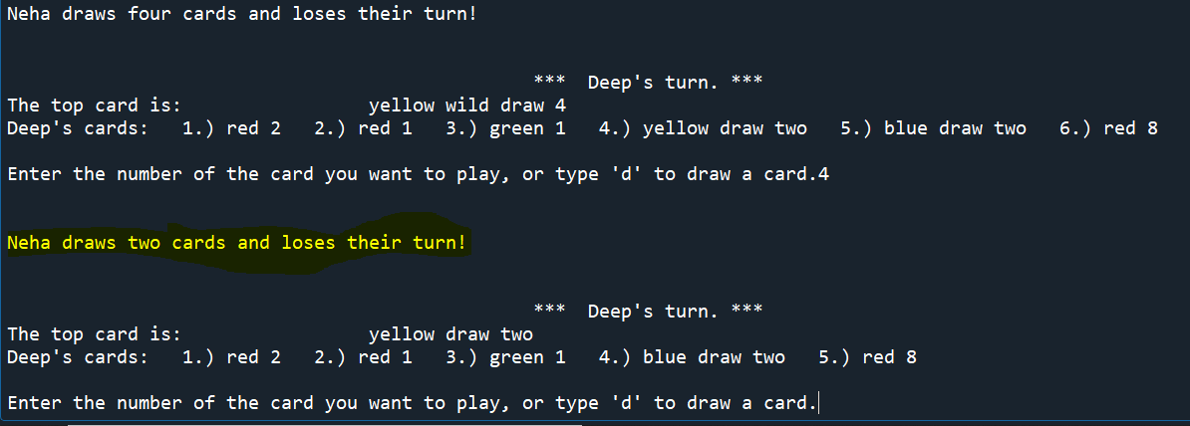
Project Demo
Player 1 played Wild draw 4 card
Player 1 played Draw 2 card

Slide 8


